Slide 1
New Deportment Policy
( IDs, Hygiene, Formal Uniform)

Slide 2
COMING TO SCHOOL WITH NO ID
Summarized Quarterly
Ex
Aug 10 + Sept. 4 + Sept. 15
For every 3 Days NO ID = Minus 1 in Deportment point from the quarter.

Slide 3
Hygiene Check
Nurse to check every Grade Level every 2 weeks
( cut finger nails and tidy/neat hair)
1st infraction + 2nd infraction + 3rd infraction
(Green Card) (Yellow Card) (Red Card)
** Cards are taken home to be signed by parent and returned to nurse.
Red Card forwarded to Prefect of Discipline for meeting with parent/s.
RED CARD = Minus 1 in Deportment points

Slide 4
FORMAL UNIFORM
Consists of :
Pre K K 2/Elementary MS HS
PE uniform White pressed and clean school shirt White pressed and clean school shirt White pressed and clean school shirt w/tie
All black sports shoes Jumper Skirt (F) Jumper Skirt (F) Skirt (F)
Short Pants (M) Long Pants (M) Long Pants (M)
All Black Leather/Leatherette School Shoes All Black Leather/Leatherette School Shoes All Black Leather/Leatherette School shoes
** These Formal School Uniform are all listed in the Student/Parent Handbook given to all parents
K 2 Formal Uniform will start SY 2022 - 2023

Slide 5
FORMAL UNIFORM (3X/wk)
Morning Duty Teachers stationed at the arrival area to check uniform
Student in improper formal uniform will be listed and called in the Prefect of Discipline (POD) office to get the colored card. Card is taken home to be signed by parent and returned to POD
1st infraction + 2nd infraction + 3rd infraction
(Green Card) (Yellow Card) (Red Card)
Parent/s of RED CARD holders will have to meet the POD
RED CARD = Minus 1 in Deportment points

Slide 6
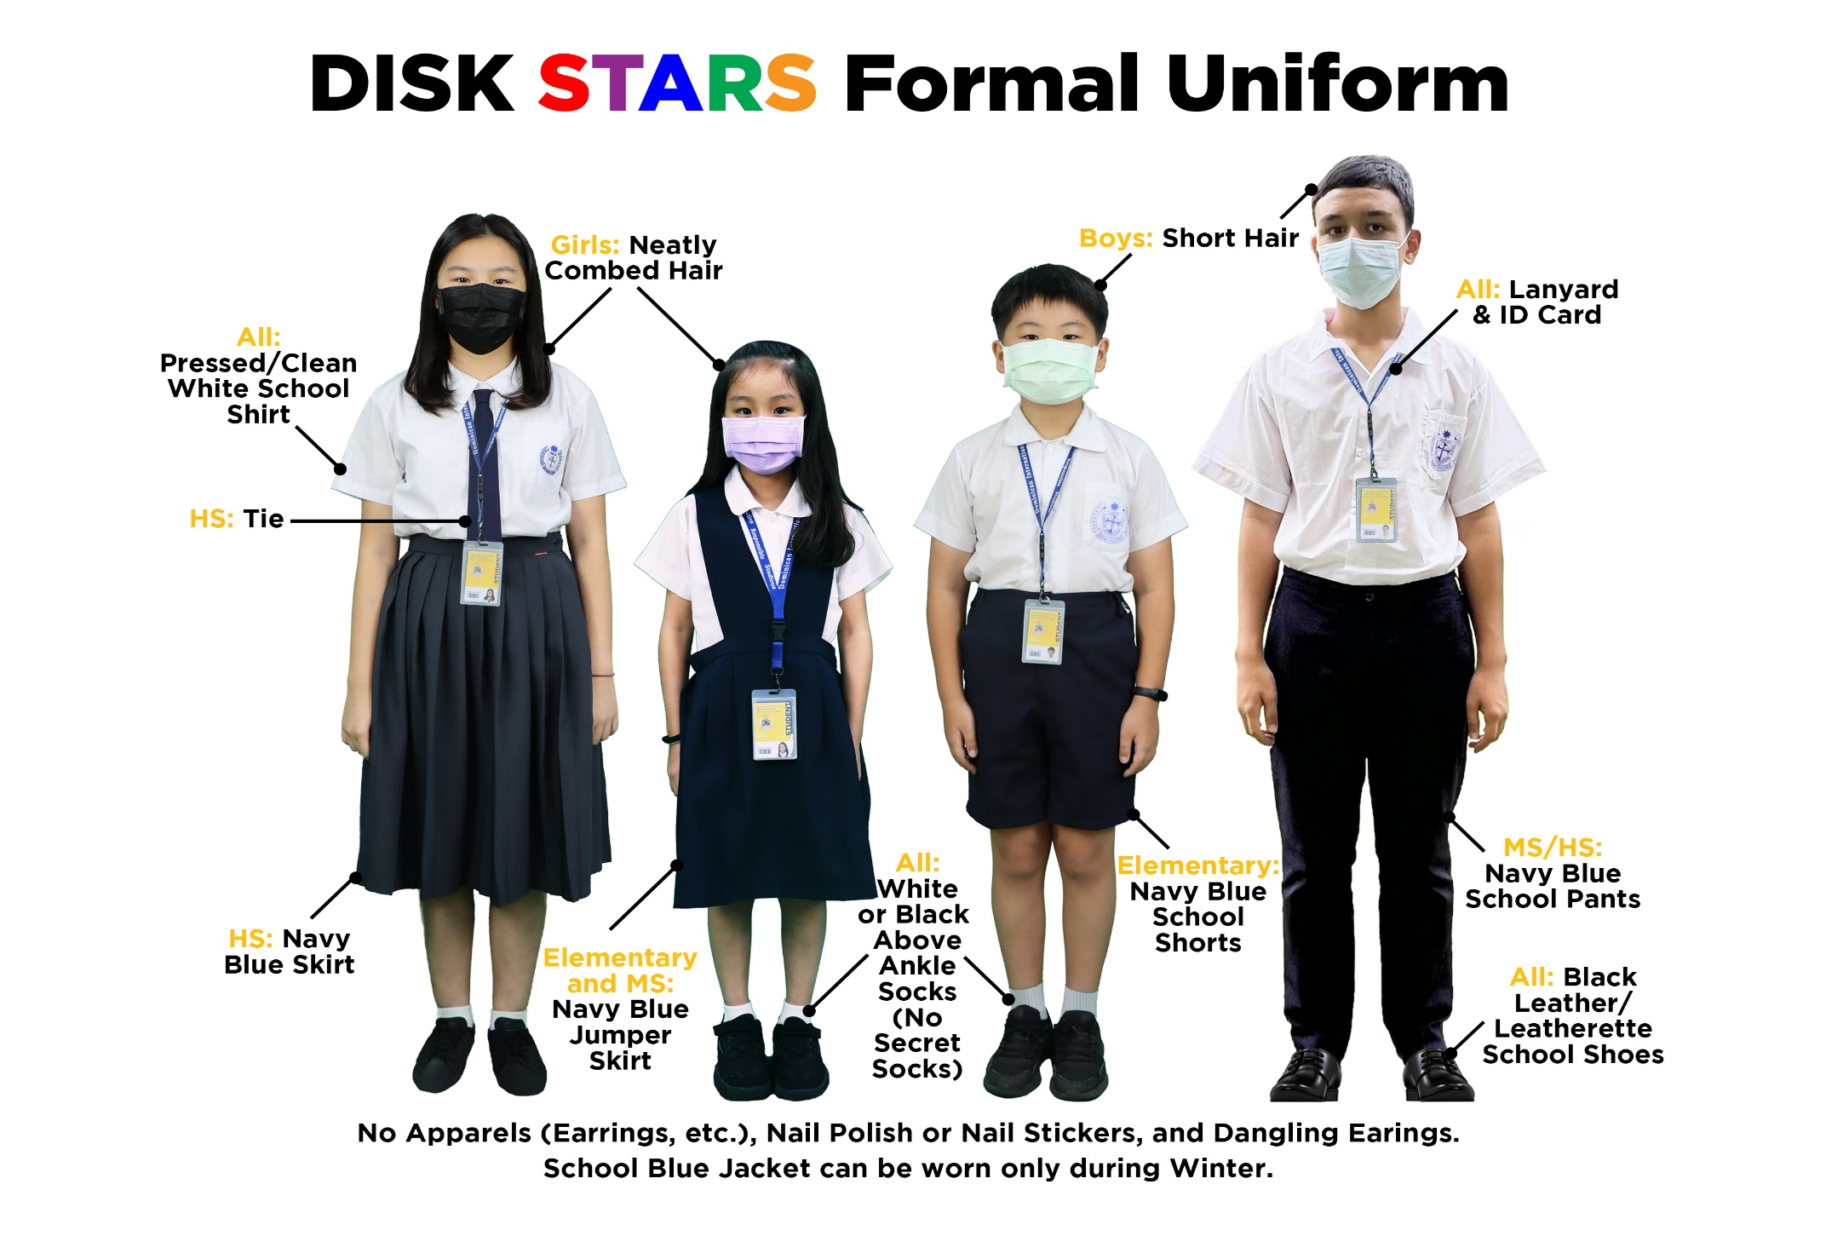

Slide 7
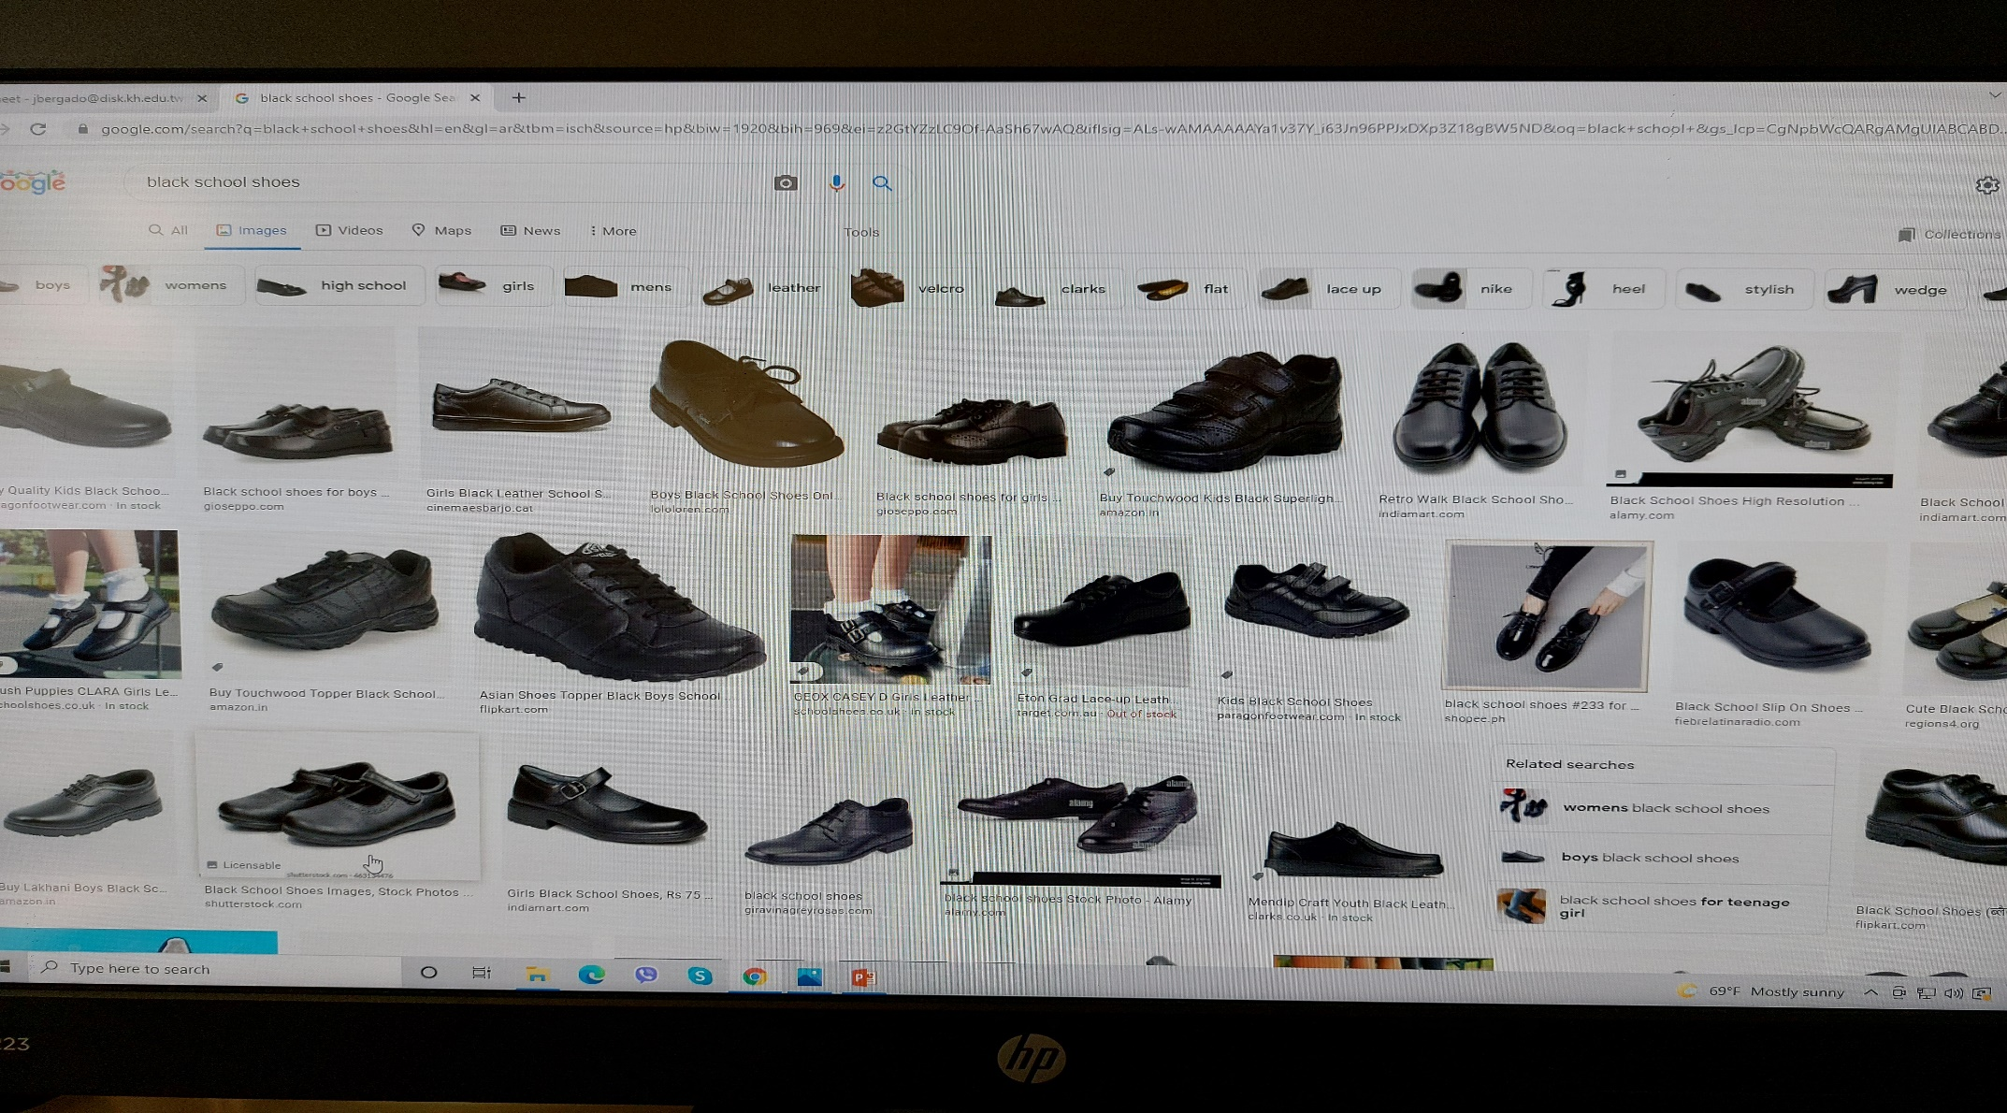
What are “black school shoes”?
Google image has images

Slide 8
RED CARD HOLDERS
DISK reserves the right to discontinue the learning service to a student who have accumulated 10 points deduction from Deportment Grade within a semester.
10 points is equivalent to 30 days of any said infraction.

Slide 9
New Deportment Policy will be fully implemented on
JANUARY 10, 2022 (Monday)
Thank you for your support and cooperation
to make DISK a DOP STARS school

